Slide 1
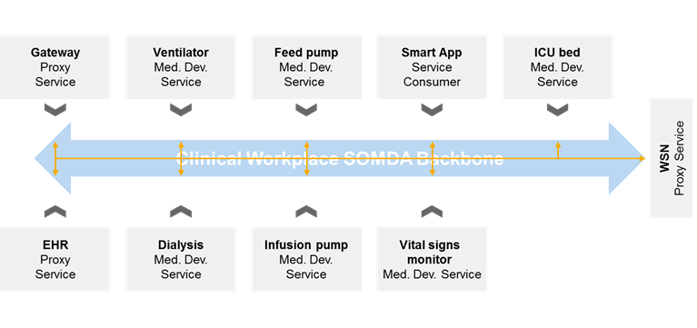
SOMDA instance

Slide 2
Abstract view
Service
Provider Consumer
Service
Provider
Service
Provider
Service
Consumer
Communication Backbone
Consumer
Provider Consumer
Provider Consumer
Provider

Slide 3


Test a provider
Test app (consumer)
Device under test (provider)
Test result

Provider

Slide 4
SDPi transactions testing of a provider
Setup a consumer that executes a sequence of tests
Reference Provider/Consumer Specification - Gemini Public - Confluence (hl7.org) (discovery, connection establishment, metric retrieval, alert retrieval, context retrieval, external control invocation)
Record the success discovering the provider, establishing a connection, retrieving metrics etc.
DONE
These are basic interoperability tests
Real providers require real test scenarios

Slide 5
Test a consumer
Test app (provider)
Device under test (consumer)
Test result
⬧
Consumer

